Slide 1
CSCI 4110 Animation Behavior Based
Mark Green
Faculty of Science
UOIT

Slide 2
Introduction
Techniques examine so far give the animator complete control of the motion, they specify every aspect
Good for main characters in an animation, but can quickly become too much work
Crowd scenes, would need to animate each person in detail, far too long
Not interested in detailed motion of character, secondary character or extra, just moving around the scene
For games can’t script the motion, character must respond to what the player does

Slide 3
Introduction
Examine a set of techniques that allow our characters to “have a life of their own”
Characters that can compute all or part of their motion
Provide high level guidance, the character figures out the details
Example: walk over there
Character determines the motion path, then the actions required to follow the path
Character can set its own goals

Slide 4
Environmental Awareness
A set of techniques where the characters or objects are aware of their environment, can react to things that are occurring
Can be as simple as a cloth that drapes overs a table, or as complicated as a completely autonomous character that can perform many actions
Real-time animation, games and VR where objects respond to user’s actions in real-time
Feature animation, scenes that are too complex to animate using key based techniques

Slide 5
Awareness
What do characters need to be aware of?
The forces acting on them
The actions of nearby characters
Terrain or ground they are moving on
Immediate goals and problems, I’m hungry now
Long term goals, I need to be somewhere tomorrow
Character can’t be aware of everything, depends upon the situation they are in
Sensor overload from too much information

Slide 6
Model
First approximation to a model:
Set of sensors, inform character of the environment
Set of behaviors, how the character responds
This gives us a start, but there is something missing, how do we connect the sensors to the behaviors?
There needs to be some decision mechanism that determines the behaviors to use in a given situation
Also need to monitor the behaviors to see if they are actually successful

Slide 7
Model
Decisions
Sensors
Behaviors
Environment

Slide 8
Model
This is a very general model, but it does allow us to classify a number of the techniques that we need
This model can also be viewed on different time scales
On a sub-second time scale the model could be monitoring the performance of a behavior, providing corrections if we are not getting the intended result
On the several second time scale the model could be doing basic collision avoidance and navigation, making sure the character doesn’t fall over things

Slide 9
Model
At the few minutes time scale the concern could be with path planning, how we can get from point A to point B in the best way, where A and B are some distance apart
On even longer time scales we could be dealing with the character’s motivations and desires
This is where the “character” comes out
As we move up the time scale the problems tend to get harder
In addition, the time scales need to coordinate, usually from longer time scales to shorter time scales

Slide 10
Sensors
What are some typical sensors?
On the shortest time scale we have forces and torques, the immediate actions of the environment
Collision detection provides some of these forces, so we will need to consider it
On a longer time scale need the information for collision avoidance, the current state of the environment the object is in
This could be done through synthetic vision, character has rendered image of the environment, or direct access to the geometrical model

Slide 11
Sensors
A map of the environment can be used for longer term planning
This map could be given to us, or we could need to build up the map as the character moves through the environment
Other sensors could be for wind, sound or smell
Sensors depend on character’s role, only what we need for decisions and behavior
Don’t need smell sensor if character never responds to it

Slide 12
Behaviors
On the shortest time scale we have physics, how the character responds to the forces and torques on it
This is a good start if we want very realistic motion, but can be difficult to control
Inverse kinematics is another low level approach
We have short term motion goals, order of a second, use inverse kinematics to determine the goal pose, interpolate from current pose to goal pose
Easier to implement and control, but may not provide natural motion

Slide 13
Behaviors
Controllers for physically based motion, produce a force or torque based on motion goal
Example: want to extend arm over a short period, controller produces torque at shoulder and elbow to move the arm
Controllers can be very hard to develop, but can account of unexpected results
Can produce a more adaptive and realistic motion
May need multiple controllers for a behavior, deal with the interaction between controllers

Slide 14
Behaviors
Longer term behaviors tends to be a combination or coordination of shorter term behaviors
Example: walking from point A to point B is a sequence of step or walking behaviors
Can build a hierarchy of behaviors based on time scale and complexity of motion
Example: walking while waving arm
Need to deal with both concurrent and sequential behaviors, have I reached a sub goal so I can start the next behavior?
What happens if I can’t reach a sub goal?

Slide 15
Decisions
Coordinate the character’s behavior, where the characters “intelligence” lies
There can be short term decisions, but we try to have the sensors and behaviors take care of this
We don’t want this component reacting to every force in the environment
At the shortest time scale could just trigger behaviors, make decisions at the second level, what do I do now is response to what just happened?

Slide 16
Decisions
Longer time scales involve planning, what is the sequence of behaviors that I need to reach my goal
Put the plan together and give it to the behavior component to execute
Path planning: determine the waypoints required to get from point A to point B
With a complete map of the environment this is still a hard problem
Without a complete map, or other moving characters this becomes far more difficult

Slide 17
Decisions
The more sophisticated our character the more difficult this is
A simple guard character just needs to plan its path and avoid any obstacles, either fixed or other characters
A more sophisticated character needs to respond to the actions of other characters
Maybe it will attempt to avoid other characters, or it could be aggressive
Individuals in a crowd may have a goal, but most of their motion will be path planning and obstacle avoidance

Slide 18
Boids
An excellent example of this model
Boids were developed by Craig Reynolds and published in Siggraph’87
They are a model of flocking and schooling behavior that can be extended to herding
Birds and fish are nice since you don’t need to worry about ground contact, terrain and things of that nature, they are free to move in 3D space
The idea is to get a number of autonomous birds to naturally flock together, and do this relatively efficiently

Slide 19
Boids - Behavior
Start with the behavior side, each boid has its own local coordinate system, and its motion is in terms of this coordinate system, see the next slide
Since each boid is independent there is no common coordinate system
The input to the behavior is an acceleration vector, moving the boid in the direction it would like to go
This acceleration vector can be integrated twice to give the position of the boid in the current frame
A velocity dependent drag can be added to give a more natural motion

Slide 20
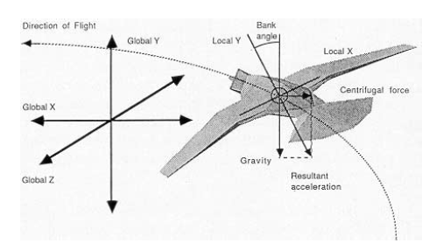
Boids - Behavior

Slide 21
Boids - Behavior
This is a pseudo-physics system or a kinematics system, we are not doing full dynamics, since there are no forces and torques involved
This is a reasonably good approximation for fish and birds
We need to consider the integration technique, the first approach that comes to mind is Euler, which works reasonably well in this system
With Euler we multiply the acceleration by the time step and add to the current velocity, we then multiply the velocity by the time step and add to the current position

Slide 22
Boids - Behavior
Euler is a simple and efficient technique, but has its problems
In general we have to use a small time step and the technique is not stable
Stability has a precise mathematical definition, but in practice an unstable system blows up, which is literally the case in animation
Boids is a stable system, so we don’t need to worry about it here, but other dynamic systems that we use in animation do suffer from stability problems when we use Euler’s method

Slide 23
Boids - Behavior
When faced with a stability problem normally we would use a technique like Runge-Kutta, but this has problems when it comes to interactive animation
We view the input to our integration method as a function f(t,y), where t is time and y is the current state of the world
In many applications f(t,y) is a simple function that can be evaluated very efficiently
This is not the case in animation, where f(t,y) involves collision detection and avoidance, computation of forces and torques, decision making, etc.

Slide 24
Boids - Behavior
For the standard Runge-Kutta method there are four evaluations of f(t,y), only one of which is on the actual path of the character
This is far too expensive for interactive animation, and can also be very hard to program and is memory intensive
We need an integration technique that only involve values of f(t,y) that lie along the character’s path and that we have already computed
There is a class of integration techniques that does this, they are called multistep techniques

Slide 25
Boids - Behavior
An example of this is the two step Adams-Bashforth technique:
y_{n+2} = y_{n+1} + 1.5hf(t_{n+1},y_{n+1}) – 0.5hf(t_{n},y_{n})
To compute the next position on the path we only need to current value of f(t,y), plus the value one step in the past
h is the time step in our solution, which is usually the same as the frame rate
This involves a small amount of extra storage and a few extra arithmetic operations

Slide 26
Boids - Behavior
With a two step method we usually need to use a value of h smaller than the frame time, that is we need to run the animation at a higher update rate than the animation display
We can use more steps, which will allow us to increase the value of h
Since we don’t need to do any extra function evaluations, multi-step methods are a good choice for real-time and interactive animation

Slide 27
Boids - Sensors
Now we turn to the boids sensors
There are two things a boid needs to sense:
Other birds in the flock
Obstacles in the environment
A flock can be quite large, so we don’t want to sense the position of all the other birds, this would be O(n²), with a flock of n birds
Instead the flock sensor has a fixed radius, birds outside this radius aren’t considered
There is also a distance weighting, which is 1/r², so closer birds are more important

Slide 28
Boids - Sensors
Boids also need to avoid any obstacles in their path, and since they are part of a flock their range of sight is limited, other boids block their view of distant objects
A force field could be used to detect these objects, but will produce responses to objects at the side as well as the ones in front of the boid
Conceptually a fixed length ray in the direction of boid flight is used to detect obstacles
We don’t need to trace a ray, we only need to check the distance between the boid and any obstacles and only report the ones in front and within the radius

Slide 29
Boids - Sensors
We can make this more efficient by using a grid structure, we place all the boids and obstacles in grid cells based on their locations
We then only need to check the near by grid cells and not all the boids in the flock
There is some maintenance involved when the boid moves between grid cells, but this is small compared to the efficiency we gain

Slide 30
Boids - Decisions
There are three basic rules of flocking behavior:
Collision Avoidance: avoid collisions with nearby flockmates
Velocity Matching: attempt to match velocity with nearby flockmates
Flock Centering: attempt to stay close to nearby flockmates
The output of the decision computation is the acceleration vector that is fed to the behavior component, so we need to convert these rules into accelerations

Slide 31
Boids - Decisions
For the first rule we generate an acceleration that points the boid away from a potential collisions with other boids
If the path of the boid appears to cross the path of another boid, we generate an acceleration that turns the boid to prevent the collision, or move it further into the future, see the next slide
The magnitude of the acceleration depends on how close the other boid is, or how soon the collision will occur

Slide 32
Boids - Decisions
New direction vector
That postpones the
collision
Collision
Point

Slide 33
Boids - Decisions
For the second rule we compute the average velocity of all the nearby boids, this average could be weighted by the distance to the boid
We then produce an acceleration that brings the boid’s velocity closer to the average
Since velocity is a vector this will tend to reduce the probability of a collision in the future, if all the boids are heading in the same direction their paths won’t cross
The boids will also tend to fly together

Slide 34
Boids - Decisions
For the third rule we compute the centroid of the nearby boids and have the boid move towards the centroid
We don’t compute the centroid of the entire flock, since the boid can’t see all of the other boids
We don’t want to use a weighted average here, since this is the rule that creates flocks
Even if the boids are far apart we want them to come together to form a flock

Slide 35
Boids - Decisions
There is a problem with the way things are now, the rules can produce contradictory accelerations, which can cancel each other out
The rules are in priority order, so this gives a hint on how we can solve this problem
A boid has a maximum acceleration, we start with the first rule and start computing accelerations
We work through the rules until the maximum acceleration is reached and we stop applying rules at that point

Slide 36
Boids - Decisions
We still need to worry about obstacles, we need to compute an acceleration that will avoid an obstacle
This can be done in basically the same way as avoiding another boid
We aim the boid so it just misses the obstacle as shown on the next slide
This acceleration has the same priority as the first rule

Slide 37
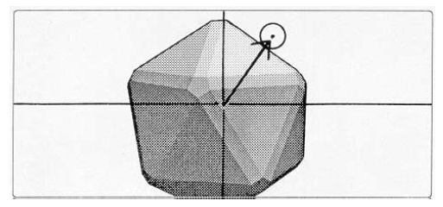
Boids - Decisions

Slide 38
Boids - Decisions
We can add other rules that can be used to guide the flock along paths
There can be an attractor that the boids will fly to similar to the flock centering rule
This attractor can be animated to produce a flock path
At the start of the animation the boids can be positioned randomly, on a grid, or they can be positioned by the animator
The flocking behavior will evolve over time

Slide 39
Boids
http://www.red3d.com/cwr/boids/applet/
http://www.youtube.com/watch?v=GUkjC-69vaw

Slide 40
Collision Detection
Objects cannot pass through each other!
We need to detect when collisions occur and then react to the collisions
Note: collisions don’t typically occur between animate objects, they are usually smart enough to avoid collisions
We can make the assumption that we are dealing with inanimate objects, over short intervals of time motion will be straight line
This gives a certain amount of frame coherence, which we can take advantage of

Slide 41
Collision Detection
The most important decision is whether an exact collision result is required
An approximate result states that there is a high probability that a collisions occurred between two objects in the last frame
We know the two objects that collided, but we don’t know when or where they collided
If there is a simple response, like a bounce this is probably good enough
In an interactive application the user may not notice that the collision isn’t exact

Slide 42
Collision Detection
This is not good enough for dynamics, we need to have a precise result
We need the following information:
The exact time of contact
The exact location of contact
The contact normal, or contact plane
This typically requires a primitive by primitive comparison, which can be very expensive
The contact plane is the plane that separates the two objects in a small region surrounding the contact point

Slide 43
Collision Detection
Contact
plane

Slide 44
Collision Detection
The contact normal is the normal to the contact plane, the collision response is along this vector
Normally collisions don’t occur exactly at frame times, they occur between frames
This can lead to missed collisions, particularly for objects that are moving quickly, see the next slide
The ball should collide with the wall, but in adjacent frames it on opposite sides of the wall, we need to detect these situations
One approach is to divide the frame into smaller intervals, this is expensive and still doesn’t guarantee we detect the collision

Slide 45

Collision Detection
Frame 1
Frame 2

Slide 46
Collision Detection
One approach to this problem is to extend collision detection to 4D, 3 spatial dimensions and one time dimension, see the next slide
Basically sweep the object along its path
This produces a more complex object, and a more difficult collision detection problem, but it does guarantee detection
Full collision detection is expensive, we would like to avoid doing the complete computation on each fame
We can assume that object don’t move too much between frames

Slide 47
Collision Detection
Frame 1
Frame 2

Slide 48
Collision Detection
We reduce the amount of work by saving decisions that we have made and then check to see if they still hold
These decisions are called witnesses and there are many types that we can use
If we find a plane that separates two objects in one frame, we can save this as a witness
Instead of doing a complete collision detection, we can check to see if the plane still separates the two objects

Slide 49
Collision Detection
Another witness is recording the collision point between two objects
We can check to see if this is still a collision point, if it is we can report it as a collision
If not, the collision point could be close by, search neighbouring vertices for a collision
Two static objects that are in contact, are likely to stay in contact
We want a witness to be fast and have a high probability of providing useful information

Slide 50
Collision Detection
Complication: floating point arithmetic isn’t precise and can cause problems for our algorithms
Quite often interested in small distances (are points touching?), the relative error can be quite high for differences
In complex computations rounding errors can accumulate, giving rise to unexpected errors
May need to rearrange computations, don’t use equality tests, etc.

Slide 51
Approximate Algorithms
Approximate algorithms are based on constructing bounding volumes for each object
The two common bounding volumes are spheres and axis aligned bounding boxes
The intersection algorithms for these shapes are quite simple
For a pair of spheres they intersect if the distance between their centers is less than the sum of their radii
We avoid the square root by squaring the sum of the radii

Slide 52
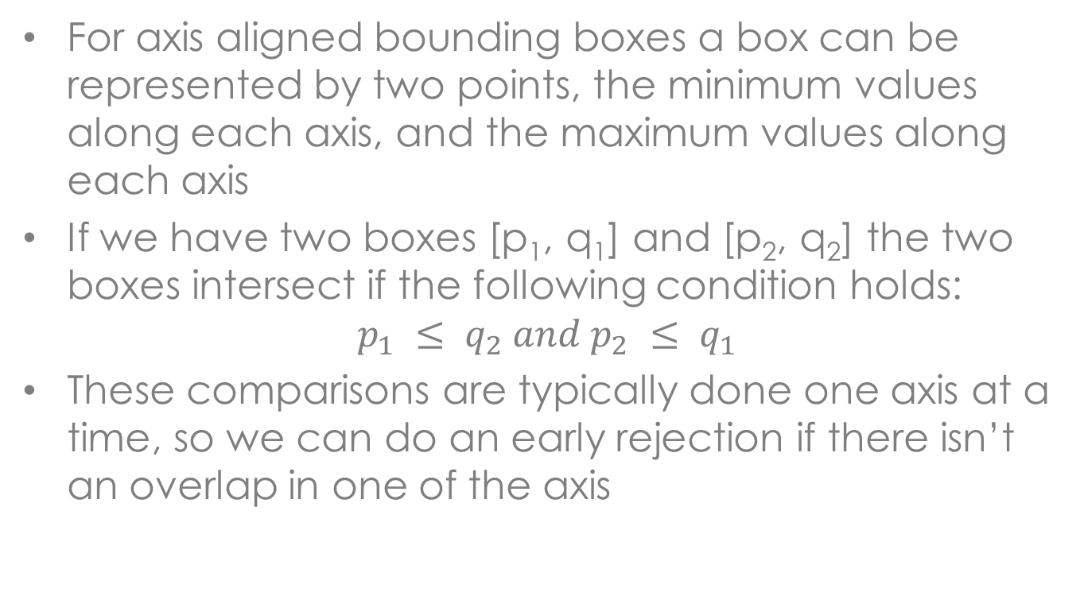
Approximate Algorithms
For axis aligned bounding boxes a box can be represented by two points, the minimum values along each axis, and the maximum values along each axis
If we have two boxes [p₁, q₁] and [p₂, q₂] the two boxes intersect if the following condition holds:
$$p_{1} ≤ q_{2} and p_{2} ≤ q_{1}$$
These comparisons are typically done one axis at a time, so we can do an early rejection if there isn’t an overlap in one of the axis

Slide 53
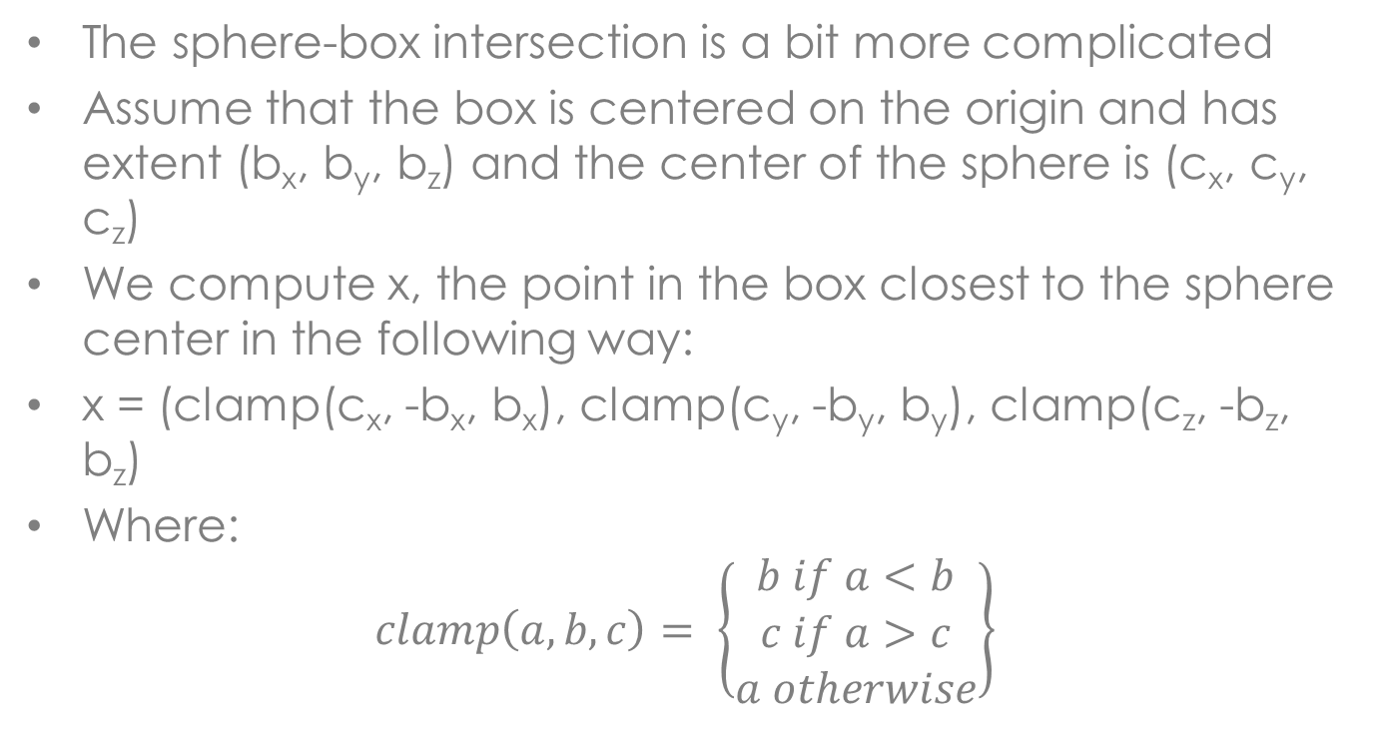
Approximate Algorithms
The sphere-box intersection is a bit more complicated
Assume that the box is centered on the origin and has extent (b_{x}, b_{y}, b_{z}) and the center of the sphere is (c_{x}, c_{y}, c_{z})
We compute x, the point in the box closest to the sphere center in the following way:
x = (clamp(c_{x}, -b_{x}, b_{x}), clamp(c_{y}, -b_{y}, b_{y}), clamp(c_{z}, -b_{z}, b_{z})
Where:
$$clamp\left(a,b,c\right)= \left\{\begin{matrix}b if a<b \\ c if a>c \\ a otherwise\end{matrix}\right\}$$

Slide 54
Approximate Algorithms
The box and sphere intersect if x is inside the sphere, in other words if the distance between x and the sphere center is less than the sphere radius
All these tests involve a small number of arithmetic operations, so they can be performed quickly
But, testing all the object pairs in O(n²), which can be expensive with a large number of objects
Given all the possible pairs of objects, collisions are very rare, most of the objects are far away and clearly don’t collide

Slide 55
Approximate Algorithms
This suggests a grid data structure, objects are allocated to grid cells, only need to test the objects in the same cell, and possibly the nearby cells
A coarse grid works okay most of the time and reduces the time required for grid maintenance
These algorithms are relatively easy to implement and most of the time they are re-implemented in new applications and packages

Slide 56
Exact Algorithms
Exact algorithms are quite complex and we won’t examine them in detail
There are a number of good exact collision detection software packages, it is better to use them than try to implement your own algorithm
These algorithms are complicated and there are quite a few details you need to be aware of
There is still some research in collision detection algorithms, but this is not a very active research area

Slide 57
Collision Avoidance
Animate objects typically don’t collide, they avoid collisions
A good decision module will move objects away from collisions, but there can still be a need for collision avoidance algorithms
There is interaction with path planning algorithms, so these are not completely sensor level algorithms
These algorithms are typically divided into detecting potential collisions and taking action to avoid them, the action part typically depends on the detection part

Slide 58
Collision Avoidance
Force fields are a general technique for handling collision avoidance
Based on constructing a force field around each of the obstacles in the environment
The force field points away from the obstacle and the magnitude is inversely proportional to the distance to the obstacle
the force field is defined for each point in the environment, the forces from all the obstacles are summed at each point
Normally there is a maximum force radius for each obstacle

Slide 59
Collision Avoidance
There are two approaches to computing the force field
One approach is to pre-compute the force field at grid points and then interpolate inside each of the grid cells
The force field tends to be smooth, so this works reasonably well
This approach only works with static obstacles
The other approach is to compute the force field on the fly, usually just considering the obstacles close to the object
This approach works with moving obstacles

Slide 60
Collision Avoidance
The output of this algorithm is a force to be applied to the object
Thus the behavior component must be able to deal with forces or accelerations
This is a very general algorithm and can be used with almost any modeling technique
There is a significant problem with this algorithm, objects can get stuck in local minima, points in the force field where the force increases in all directions
This causes the object to stop moving, or just jiggle around

Slide 61
Collision Avoidance
There are several ways of avoiding this problem
One solution is to cap the force beyond a particular radius from the obstacle
This will hopefully produce large areas of zero force
Another approach is to have the force grow rapidly as the object get quite close to the obstacle
If the object is not close to the obstacle the force will have limited impact on its motion
Another approach is to add a random perturbation to the force if the object appears to get stuck

Slide 62
Collision Avoidance
Another problem with this approach is it doesn’t consider the direction of object motion
It applies the same force to an object moving parallel to the obstacle as one heading directly towards it
This can be fixed by taking the dot product of the velocity vector and the force vector, both normalized, and using this to weight the force
Now if the object is moving parallel to the obstacle it will not respond to the force

Slide 63
Collision Avoidance
Force fields can be used for other types of motions
The direction of the force field can be reversed to produce an attractor, a location the characters will move towards
This attractor can be animated to lead the characters through the environment
The combination of positive and negative forces can be used to guide characters through the environment
Can be used to move crowds in a particular direction

Slide 64
Collision Avoidance
Simulated vision can be used to detect obstacles
In this approach a low resolution rendering of the environment is produced from the character’s viewpoint
This identifies the closest obstacles that are in front of the character
The depth buffer can be retrieved and analyzed to find the location of the closest obstacle
The obstacles near the center of the image are more important, since they are directly in front of the character

Slide 65
Collision Avoidance
If the rendering is done with an object identifier instead of a colour, the image buffer can be used to identify the obstacle
This technique has two main advantages
It can be used with any object that can be rendered, the collision avoidance rendering can be different from the image rendering
It’s quite realistic, since characters will only respond the obstacles it can actually see, it won’t respond to obstacles that are hidden

Slide 66
Collision Avoidance
The main problem with this approach is the time required
First the environment must be rendered and then the depth buffer must be analyzed to see if there are any possible collisions
If there are only a few characters this isn’t much of a problem, but for a large number of characters it could be a problem
If there are a large number of characters one rendering could be done for a group from the average position and then shared by the group

Slide 67
Collision Avoidance
The final technique is conceptually based on ray tracing
We construct a ray with its origin at the characters position and the velocity vector as the ray direction
We then find the closest intersection with the ray and that is the object we want to avoid
If the objects have bounding boxes or spheres we can actually do a ray trace, since the intersection computations are relatively quick
Again this will only select the obstacles that are visible to the character

Slide 68
Collision Avoidance
This can also be done by searching the character’s neighbourhood for nearby obstacles
This search can be restricted to the obstacles that are in front of the character
This can be reasonably efficient if a grid data structure is used
This covers the general purpose sensors that most characters will need
In addition there are some special purpose sensors

Slide 69
Other Sensors
Wind, light and smell sensors can be used for particular types of characters or special types of motions
Wind is often represented by a velocity field, the wind velocity at a particular location is then used as an input to the behavior computation
Lights can either be a point or a direction that attracts or repels the character
Smell can be used in the same way, or it can be used as a marker for communications between characters

Slide 70
Behaviors
Before looking at the individual techniques we need to explore the nature of behaviors in more detail
A behavior is a small unit of motion, it typically lasts for a few seconds, but it can last much longer
A character can perform multiple behaviors at the same time
View this as the motion vocabulary for the character
Decision component selects the behaviors that it wants active at a particular point in time, viewed as tasks or processes

Slide 71
Behaviors
Behaviors typically have parameters, a general behavior procedure, parameters specify the particular motion that we want
Example: walk behavior, parameters could be the goal or direction of walking, speed, gait, etc.
Behaviors also have durations, this could be an absolute duration specified in seconds, or it could be a condition or event that terminates the behavior
Example: the walking behavior terminates when we reach the goal

Slide 72
Behaviors
Ideally a behavior is autonomous, we trigger the behavior and then we let it run
Ideally behaviors should monitor their own performance, adapt if they aren’t meeting their goals
Not all behavior systems do this, decision component must monitor their performance and adjust accordingly
Forces decision component into making short term decisions instead of long term planning
Interface between behaviors and decisions can be quite fuzzy

Slide 73
Characters
There are three main character types:
Rigid: no internal motion, the character can move through space, but there is not relative movement of its parts
Articulated: characters consist of a number of rigid parts that are connected by joints, joints allow rotation or translation of one part with respect to another
Deformable: the individual parts can have motion, usually a deformation of the surface, motion at the vertex level
The different types are hierarchical, basic motion of a deformable character driven by articulated skeleton

Slide 74
Behaviors
There are a number of common behavior systems, we will examine the following ones:
Key based techniques
Motion capture
Kinematics
Inverse kinematics
Dynamics

Slide 75
Key Based Techniques
Short animation sequence produced using keys
Duration typically less than a second, so character can respond to environment
Example: a single walking cycle
Animator produces a set of animations, must be able to transition between animations, usually occurs at the end of the animation
Bring character to a neutral position, all animations start from this position
If not possible produce short animations that bring the character to the neutral position

Slide 76
Key Based Techniques
Not always possible, end up with sets of behaviors that can transition, but can’t transition between all sets of behaviors
May need to combine several behaviors, example skate at the same time you are shooting the puck
This requires very careful design of the animation
The advantage of this technique are:
There are a lot of trained animators that can do this work,
There are good tools
A well defined task, easy to understand

Slide 77
Key Based Techniques
There are some significant problems with this approach
For a main character there can be very many behaviors and they will need to work together
All the animations must be carefully planned, and if one changes you may need to redo a lot of the other ones
Must prepare for all situations, even the hard ones
Example: early hockey games couldn’t get the player back on their feet after they had fallen, always move the action away from a fallen player

Slide 78
Key Based Techniques
Characters can’t respond to the environment, they must follow the animation
Example: skating is good, the surface is level
Walking over uneven terrain doesn’t work, the character looks like they are floating over the ground
Characters run into objects and they keep on moving like nothing has happened
Must have a very constrained environment where you have control over the events that can occur, difficult in interactive animation

Slide 79
Motion Capture
Similar issues to key based techniques, but typically have more realistic motion
Capture an actor performing a motion with high speed cameras
From the video identify skeleton, important joints and the motions of the joints
End product is a articulated figure or skeleton and the rotations and translations required for the motion
The problems occur when you need to stich the motions together, need a clean join between the segments

Slide 80
Vicon Motion Capture
https://www.youtube.com/watch?v=2uDnW4AtFiE

Slide 81
Motion Capture
For a complete motion capture driven system need to capture both the behaviors and the transitions
A good motion capture studio can do this quite quickly, can have all the behaviors you need in a few days
Modern techniques use motion capture as the starting point, the raw input to another behavior technique
Parameterize the motion so it can be used in many situations, fit a model to several motion sequences to determine the basic motion and how it can be tweaked

Slide 82
Motion Capture
Combine motion capture with physics, develop a model of the forces and torques in the motion
Feed these into a dynamics simulation, or impose some dynamics constraints on the motion
Can still have problems responding to events in the environment
This is an active research area, particularly parameterizing motion and the transitions between different behaviors

Slide 83
Kinematics
Physics without considering forces and torques
The input to the simulation is accelerations, need to integrate to get velocity and position
Have seen this with boids
Problem: where do the accelerations come from?
We need to have a new set of accelerations on each update, at least 60/second
This introduces the idea of a controller, a software device that produces the accelerations for the current time step based on the state of the character and the state of the environment

Slide 84
Kinematics
The input to the controller is sensor readings, these sensors could be on the character and sense the current state of the character, or they could be simple environmental sensors
Example: a contact sensor, determines whether a foot is in contact with the ground, a binary sensor
Example: joint angle sensor, could be the value of the angle, or whether the joint has reached its limits
Many of the sensors tend to be binary, sense an event in the environment, but some are continuous, such as joint angles or position

Slide 85
Kinematics
We have already seen example of controllers in boids, the three laws of boid motion were translated into controllers
There can be multiple controllers acting on a character, there is a need to coordinate these actions
Controllers are very important in dynamics as well, so we will discuss them later after we have covered dynamics

Slide 86
Inverse Kinematics
Inverse kinematics is used with articulated bodies to position them to reach goal positions
An articulated body is similar to a skeleton or hierarchical model, it consists of rigid segment that are connected by joints
Joints are typically of two types, rotation and translation, typically the rotation is about a single axis
We can view this as rigid geometry segments connected by transformation matrices, arranged as a tree

Slide 87
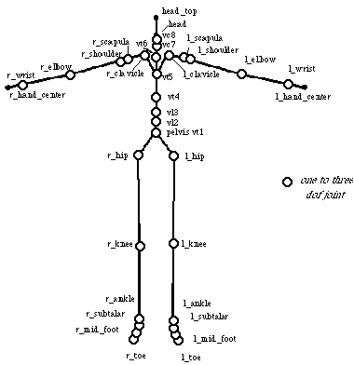
Articulate Body

Slide 88
Inverse Kinematics
The root of the tree can have translation and rotation in 3D space, the rest of the transformations are typically rotations
The leafs of the tree are called the end effectors
In forward kinematics we compute the positions of the end effectors, and the rest of the links along the chain
In inverse kinematics we are given the positions of the end effectors and we compute the transformations required to achieve that position
This is the harder of the two problems

Slide 89
Inverse Kinematics
Our controllers position the end effectors over time and the character follows these positions
Our goal can be an end effector position, but there are two other possibilities:
The end effector pointing in a particular direction
The end effector not reaching its goal, but getting as close as possible
We need to be careful with the second goal, when the joints become completely extended the problem becomes mathematically unstable and the motion can be quite erratic
We try to avoid positions where the joints are close to maximum extension

Slide 90
Inverse Kinematics
There are many ways of solving the inverse kinematics problem, and there is still research in this area, research aimed at producing more natural motion
Present the mathematical definition of the problem and look at some of the suggested solution techniques to get a feel for how the technique works
There are n parameters that determine the state of the character, we can view them as rotation angles θ_{i} about the joints, but they could also be translations

Slide 91
Inverse Kinematics
We have k end effectors and their positions are given by s₁, s₂, … s_{k}, each of these values is a 3D point so we have a total of m = 3k scalars that we can write as a column vector s
For each end effector s_{i} we have a target position t_{i}, this could be a static position, or it could be moving over time
We want to move the end effector by e_{i} = t_{i} – s_{i} to reach the target position
Using forward kinematics we can find the position of s_{i} given the values of the θ parameters

Slide 92
Inverse Kinematics
We can write this as a function s_{i} = s_{i}(θ), where θ is the vector of n parameters
Extending this further to vector notation we have s = s(θ)
The inverse kinematics problem is to find the values of θ that satisfy the following set of equations:
t_{i} = s_{i}(θ)
For very simple systems we can solve this explicitly, but for any interesting system we need to solve it numerically

Slide 93
Inverse Kinematics
We can have one solution to this set of equations, no solution, or more typically many solutions
Numerically, a single solution is very unstable and we rarely see it in practice
These equations are very nasty to solve numerically, so we turn to an approximation
We are going to linearize the equations, so we can use linear algebra to solve them
Since we are working over short time periods this is a reasonable assumption, assume acceleration is constant over short periods of time

Slide 94
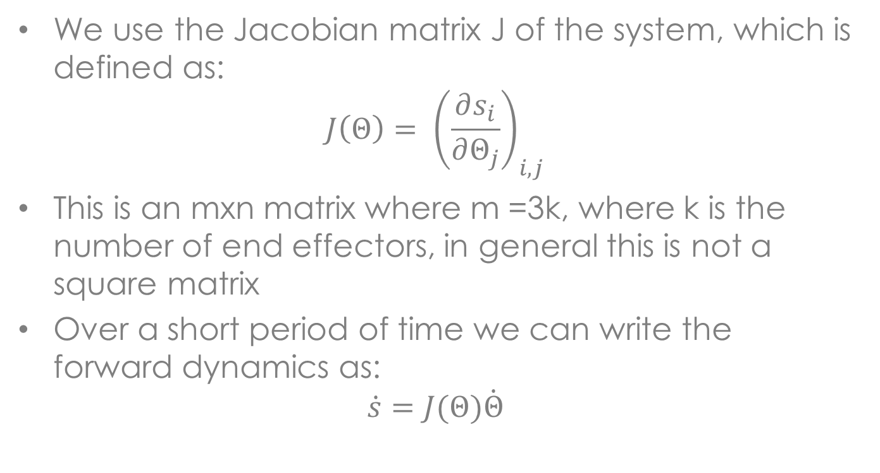
Inverse Kinematics
We use the Jacobian matrix J of the system, which is defined as:
$$J\left(Θ\right)= {\left(\frac{∂s_{i}}{∂Θ_{j}}\right)}_{i,j}$$
This is an mxn matrix where m =3k, where k is the number of end effectors, in general this is not a square matrix
Over a short period of time we can write the forward dynamics as:
$$\dot{s}=J(Θ)\dot{Θ}$$

Slide 95
Inverse Kinematics
We can now approach the solution of the inverse kinematics problem in the following way
At each time step we have the current values of s, t and θ, from these we can compute the current value of the Jacobian
Now we need to compute an update value Δθ that can be used to update θ in the following way:
θ = θ +Δθ
We want to choose Δθ in a way that Δs approaches e, the difference between s and the target position t

Slide 96
Inverse Kinematics
We can approximate Δs in the following way:
Δs = J(θ)Δθ
We now set e to this value to give:
e = J(θ)Δθ
The only unknown in this equation is Δθ, so that is what we need to solve for
If J was a square matrix, we could just invert J to get the solution, but unfortunately this isn’t the case
We will briefly examine the two simplest approaches to solving this equation, there are far more sophisticated techniques

Slide 97
Inverse Kinematics
Since we can’t compute the inverse of J we can use the transpose instead, that is we use
Δθ = αJ^{T}e
The problem with this approach is we need to estimate the value of α, which is not particularly easy
The other approach is to use the pseudo inverse of J, which is a matrix that behaves like an inverse but isn’t a square matrix
This gives the following solution:
Δθ = J⁺e

Slide 98
Inverse Kinematics
The pseudo inverse A⁺ of any matrix A is unique, always exists and has the following properties:
AA⁺A = A
A⁺AA⁺ = A⁺
(AA⁺)^{T} = AA⁺
(A⁺A)^{T} = A⁺A
The pseudo inverse can be computed using SVD, which is available in most linear algebra packages
This technique works reasonably well if the character doesn’t need to extend its limbs too far, otherwise it tends to get unstable

Slide 99
Dynamics
This is a big topic, we will just look at a small part of it
Start with some of the simpler mathematics, then explain articulated body dynamics, continue with low level controllers and finish with one of the open source dynamics packages
A topic that has been studied for centuries in physics and of importance to many different areas
Our interest is in real-time dynamics, ability to compute solution on the fly
Research in this area started in the 1980s and continues to today

Slide 100
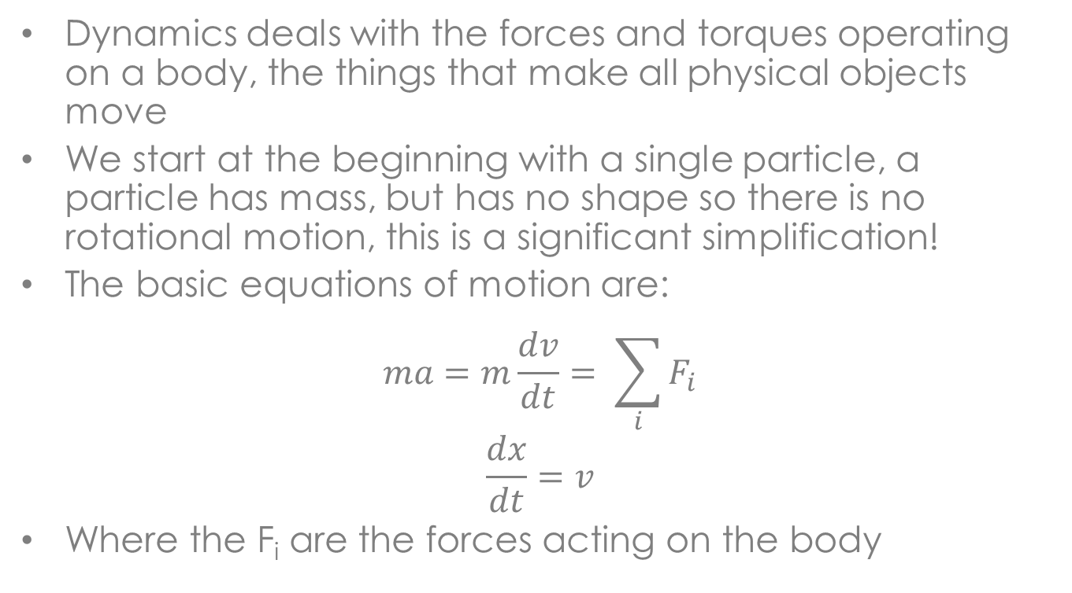
Dynamics
Dynamics deals with the forces and torques operating on a body, the things that make all physical objects move
We start at the beginning with a single particle, a particle has mass, but has no shape so there is no rotational motion, this is a significant simplification!
The basic equations of motion are:
$$ma=m\frac{dv}{dt}= \sum_{i}{F_{i}}$$
$$\frac{dx}{dt}=v$$
Where the F_{i} are the forces acting on the body

Slide 101
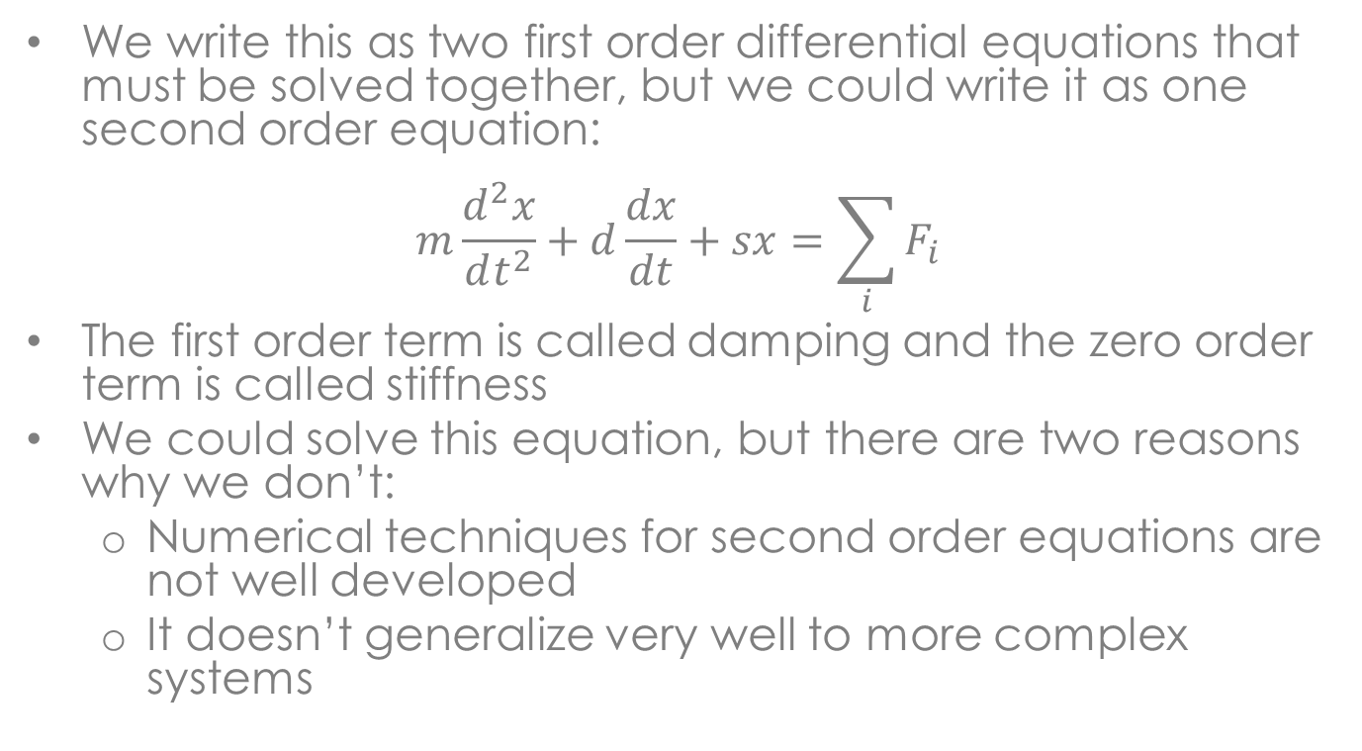
Dynamics
We write this as two first order differential equations that must be solved together, but we could write it as one second order equation:
$$m\frac{d^{2}x}{dt^{2}}+d\frac{dx}{dt}+sx=\sum_{i}{F_{i}}$$
The first order term is called damping and the zero order term is called stiffness
We could solve this equation, but there are two reasons why we don’t:
Numerical techniques for second order equations are not well developed
It doesn’t generalize very well to more complex systems

Slide 102
Dynamics
A rigid body can translate and rotate, but there is no internal motion – it is a single solid
In 3D there are many ways of formulating the equations of motion
While all the equations are correct, some techniques have advantages over others
We want a formulation that generalizes, so we can use it for any rigid body, we want to write the code once, not for each object
Some formulations are much easier to deal with numerically, and we are interested in solving these equations

Slide 103
Dynamics
One of the better formulations for animation is based on using two coordinate systems:
Inertial or global coordinate system
Body centered coordinate system
This approach is natural for computer graphics, we already use it for modeling and display
The origin of the body coordinate system is the centre of mass, and the axis are the principle axis of the body, which we will define later
This choice simplifies the mathematics

Slide 104
Dynamics
Given a point p’ on body i in its body coordinate system we can compute its position p in the inertial coordinate system in the following way:
p = c_{i} + R_{i}p’
Where R_{i} is a 3x3 rotation matrix, this c_{i} and R_{i} can be used to easily construct a transformation matrix for body i when it comes to display
The centre of mass moves just like a particle with all the body’s mass concentrated at one point
Thus, for the centre of mass we can use the same equations that we used for particles

Slide 105
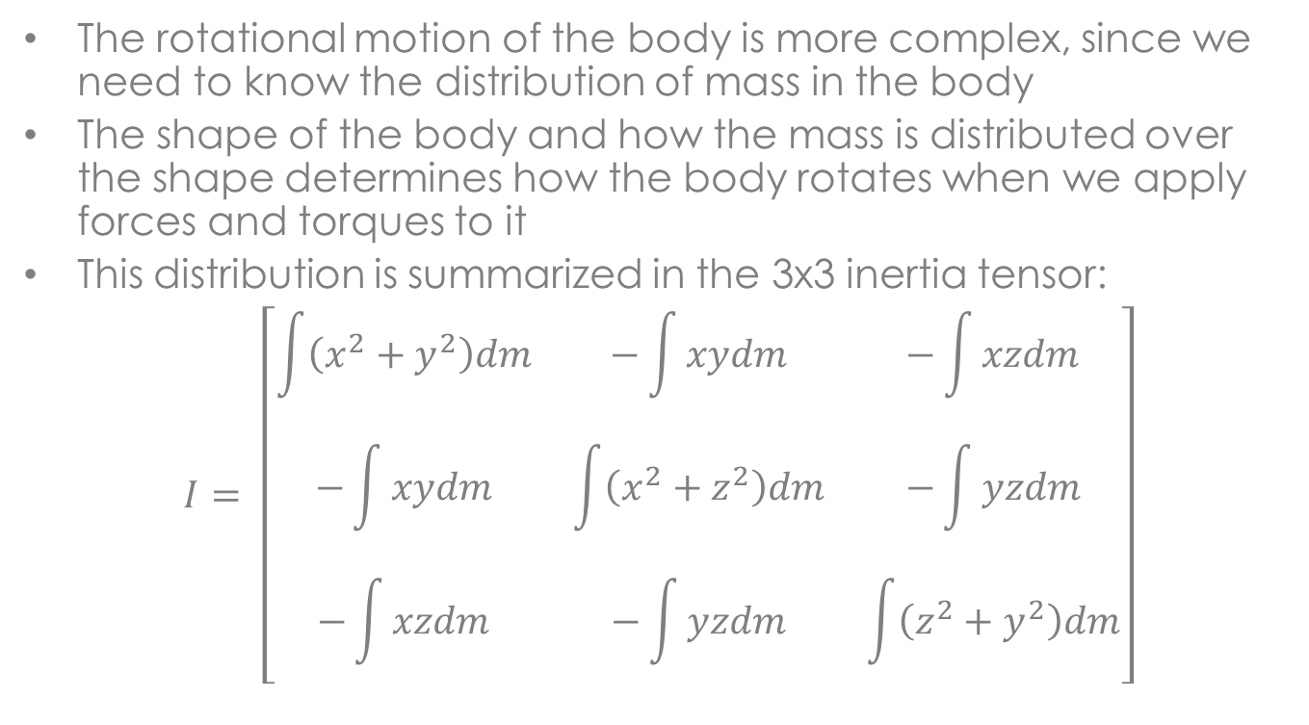
Dynamics
The rotational motion of the body is more complex, since we need to know the distribution of mass in the body
The shape of the body and how the mass is distributed over the shape determines how the body rotates when we apply forces and torques to it
This distribution is summarized in the 3x3 inertia tensor:
$$I= \left[\begin{matrix}\int{\left(x^{2}+y^{2}\right)dm} & −\int{xydm} & −\int{xzdm} \\ −\int{xydm} & \int{\left(x^{2}+z^{2}\right)dm} & −\int{yzdm} \\ −\int{xzdm} & −\int{yzdm} & \int{\left(z^{2}+y^{2}\right)dm}\end{matrix}\right]$$

Slide 106
Dynamics
All the integrals are performed over the volume of the body
While I looks relatively complicated, it is rather easy to compute, there are algorithms for computing I for convex polygonal objects, and there are theorems that allow us to compute I for parts of a body and then combine them for a complete I
In the inertial coordinate system I is not constant and needs to be recomputed on each frame
But in the body coordinate system I is constant, so we compute the rotational part of the motion in the body coordinate system

Slide 107
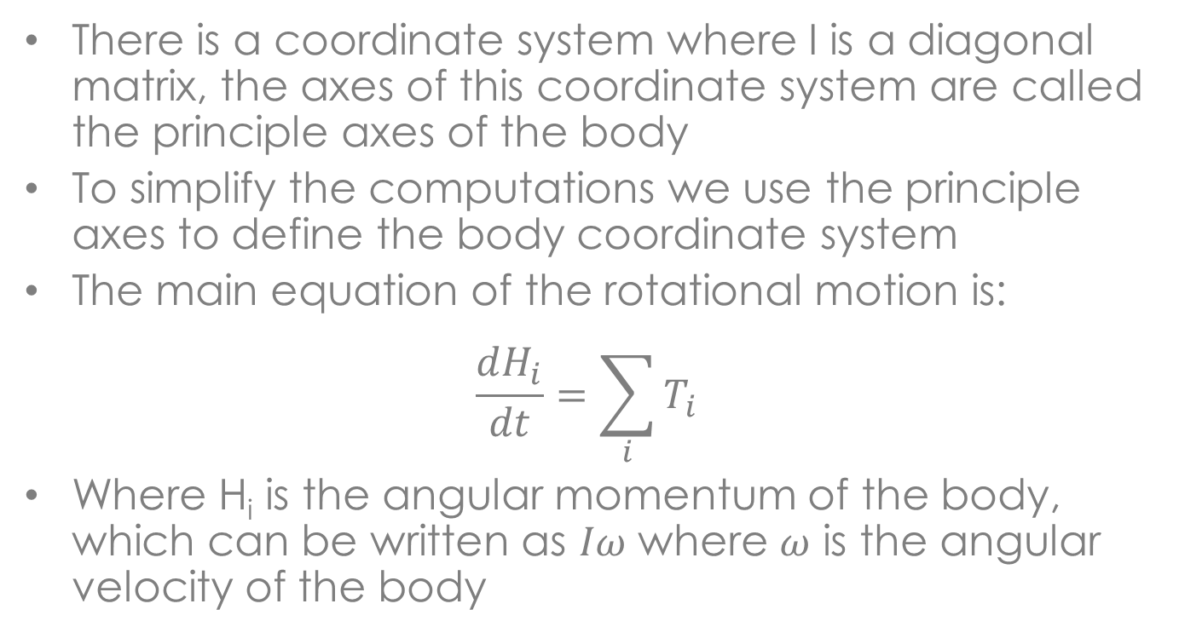
Dynamics
There is a coordinate system where I is a diagonal matrix, the axes of this coordinate system are called the principle axes of the body
To simplify the computations we use the principle axes to define the body coordinate system
The main equation of the rotational motion is:
$$\frac{dH_{i}}{dt}=\sum_{i}{T_{i}}$$
Where H_{i} is the angular momentum of the body, which can be written as $Iω$ where $ω$ is the angular velocity of the body

Slide 108
Dynamics
The T_{i} are the torques applied to the body
A torque can be a pure rotation applied to the centre of mass, or it can be generated by a force applied to a point other than the centre of mass
The torque T_{i} resulting from a force F_{i} applied at the point p_{i} is given by:
T_{i} = p_{i} x F_{i}
All of this is in the inertial coordinate system, which is not what we want
We want to compute in the body coordinate system and then convert to inertial coordinates

Slide 109
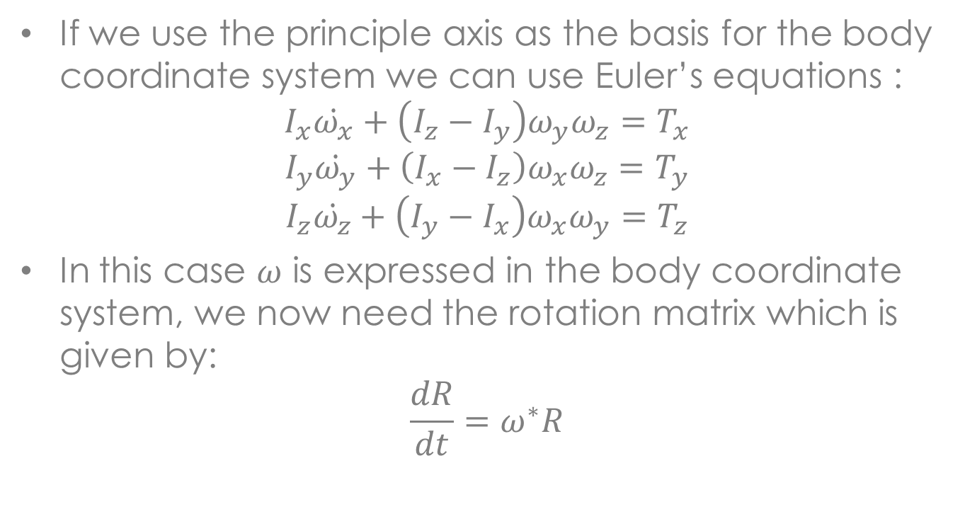
Dynamics
If we use the principle axis as the basis for the body coordinate system we can use Euler’s equations :
$$I_{x}\dot{ω_{x}}+\left(I_{z}−I_{y}\right)ω_{y}ω_{z}=T_{x}$$
$$I_{y}\dot{ω_{y}}+\left(I_{x}−I_{z}\right)ω_{x}ω_{z}=T_{y}$$
$$I_{z}\dot{ω_{z}}+\left(I_{y}−I_{x}\right)ω_{x}ω_{y}=T_{z}$$
In this case $ω$ is expressed in the body coordinate system, we now need the rotation matrix which is given by:
$$\frac{dR}{dt}=ω^{∗}R$$

Slide 110
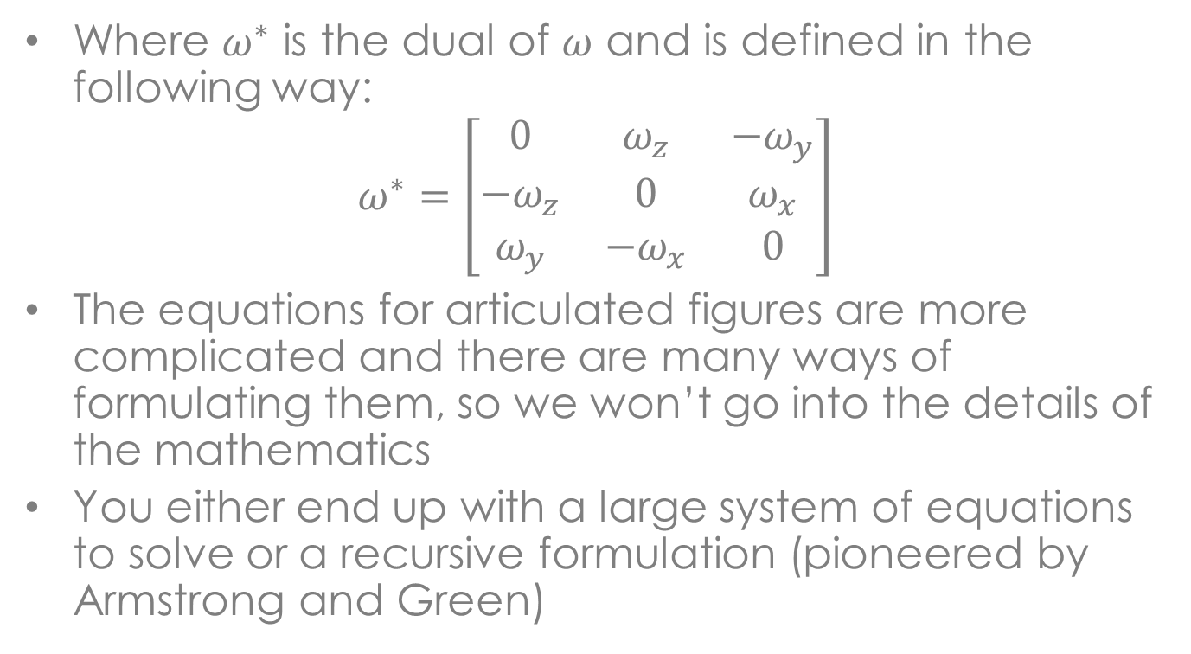
Dynamics
Where $ω^{∗}$ is the dual of $ω$ and is defined in the following way:
$$ω^{∗}=\left[\begin{matrix}0 & ω_{z} & −ω_{y} \\ −ω_{z} & 0 & ω_{x} \\ ω_{y} & −ω_{x} & 0\end{matrix}\right]$$
The equations for articulated figures are more complicated and there are many ways of formulating them, so we won’t go into the details of the mathematics
You either end up with a large system of equations to solve or a recursive formulation (pioneered by Armstrong and Green)

Slide 111
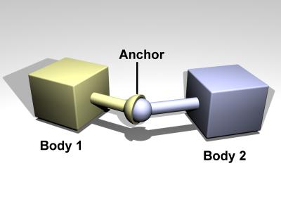
Dynamics
The key to articulated bodies are the joints between the segments
Each of the segments can be viewed as a rigid body and the joints are constraints on their motion
There are three common joint types, the ball and socket joint allows for full 3DOF rotation

Slide 112
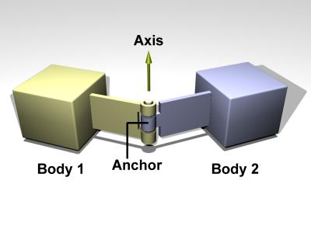
Dynamics
The ball and socket joint occurs at the shoulder and hips, more common is the hinge joint, for example the elbows and knees
The hinge joint allows rotation about a single axis:

Slide 113
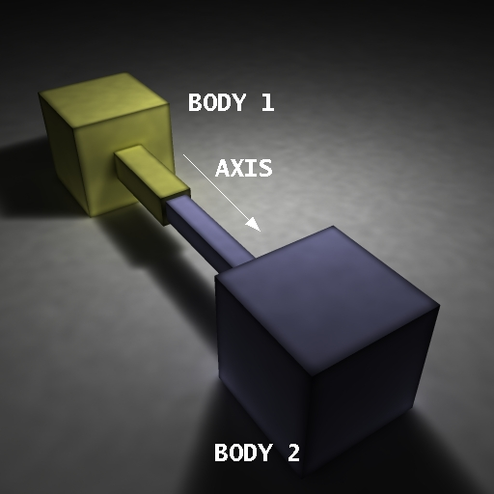
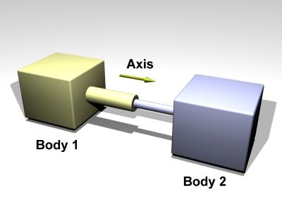
Dynamics
The piston joint allows for translational motion, this joint doesn’t occur in the human body, but it does occur in a number of mechanical systems
Single axis of rotation
No rotation

Slide 114
Dynamics
The next question is where do the forces and torques come from?
There will be external forces acting on the object, things like the force of gravity, contact forces with ground, objects the hit the body, etc.
But, these forces don’t produce interesting behaviors, we need something that applies torques or forces to the joints
We start with the lowest level controllers, which are usually part of the dynamics software and not strictly part of decisions

Slide 115
Dynamics
Numerous attempts were made at low level controllers, basically we have desired position for the joints and we want to drive them to that desired position
Conceptually one way of doing this is to attach a spring between the joint and the desired position
The rest length of this spring is zero, so it should eventually pull the joint to the desired position
Unfortunately this tends to overshoot the position, the spring generates acceleration, and we have no way of stopping it when it reaches the goal

Slide 116
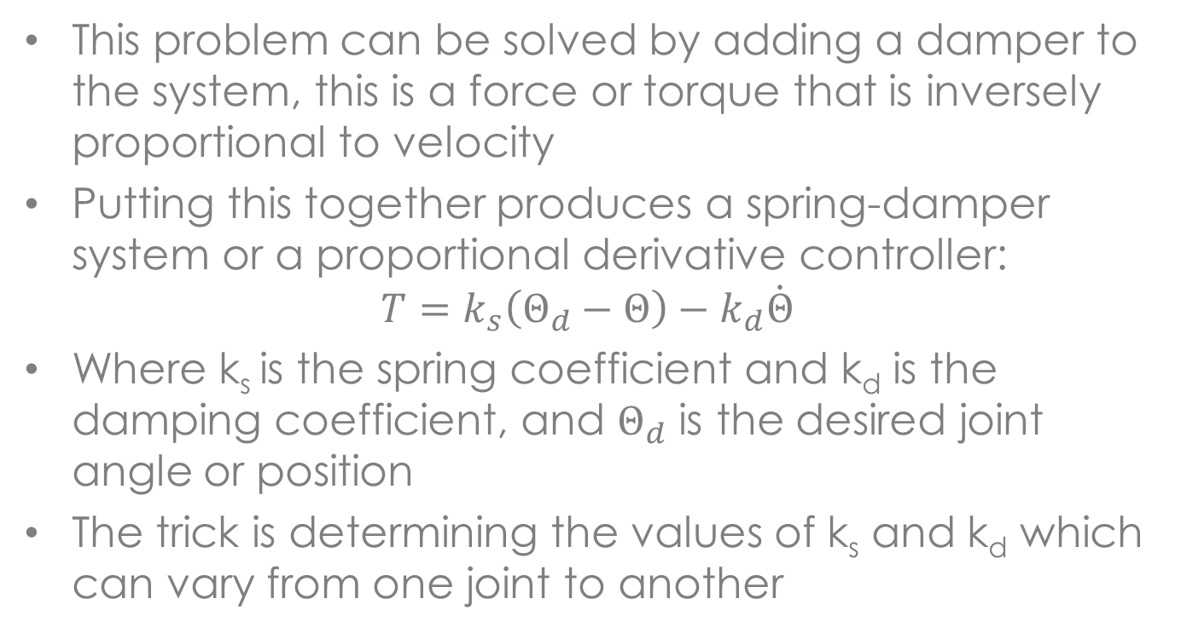
Dynamics
This problem can be solved by adding a damper to the system, this is a force or torque that is inversely proportional to velocity
Putting this together produces a spring-damper system or a proportional derivative controller:
$$T=k_{s}\left(Θ_{d}−Θ\right)−k_{d}\dot{Θ}$$
Where k_{s} is the spring coefficient and k_{d} is the damping coefficient, and $Θ_{d}$ is the desired joint angle or position
The trick is determining the values of k_{s} and k_{d} which can vary from one joint to another

Slide 117
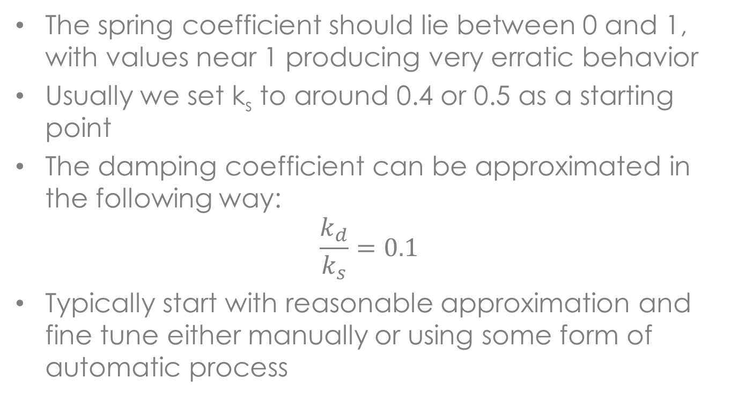
Dynamics
The spring coefficient should lie between 0 and 1, with values near 1 producing very erratic behavior
Usually we set k_{s} to around 0.4 or 0.5 as a starting point
The damping coefficient can be approximated in the following way:
$$\frac{k_{d}}{k_{s}}=0.1$$
Typically start with reasonable approximation and fine tune either manually or using some form of automatic process

Slide 118
Dynamics
There are a number of software packages that can be used for computing dynamics
Many 3D game engines have some form of dynamics package, these are usually tightly integrated with the game engine
The binary version of the Havok physics engine is freely available and is a high quality dynamics package
NVidia has the PhysX package that is available to developers, you need to have a developer account with NVidia and access to their PhysX program

Slide 119
Dynamics
The ODE package (www.ode.org) is an open source dynamics package that is used by the animation community
It does both rigid body and articulated body dynamics with a wide range of joint types
It has functions for computing the mass properties of common objects including the inertia tensor
It also has several collision detection libraries and has a standard method for responding to collisions
The main objects in this library are nodes, joints and collision geometry

Slide 120
Dynamics
Nodes have positions and mass properties and joints are used to connect the nodes
The nodes are created first and positioned within the global coordinate system
The joints are then added to the nodes and joint parameters are set
The collision objects have the geometry for the nodes or objects
In the simulation loop forces and torques can be directly applied to nodes or through joints connecting them

Slide 121
Dynamics
Collisions are detected and special collision joints are created to respond to the collision
A collision joint only lasts for a single time step, and is removed at the end of the time step
ODE has two integration techniques, one is a slow technique that is accurate and the other is a faster technique that is not as accurate
There is also a wide range of parameters that control the solution process

Slide 122
Decisions
The techniques used for decisions depends upon the time scale
At the shortest time scale we have controllers that execute every time step and provide the basic input to the behaviors
This is the fuzzy interface between behaviors and decisions
At the next level up is the coordination of controllers, determining which controllers are running and the ones that have priority, this level works at the multiple second level

Slide 123
Decisions
The next level up includes goal satisfaction planning and path planning
This level tends to operate at the minutes level
We can extend this further up the time scale, but that isn’t typical in most interactive animation and game applications
Before looking at controllers we will examine the next level up, the coordination of controllers
There are two general techniques that are used at this level and at first glance they look to very similar if not the same

Slide 124
Decisions
The first technique is finite state machines, which is usually represented using a graph
The controllers or behaviors form the nodes of this graph and the edges are events that occur in the environment
These events either originate in the environment or are internal to the character
The next slide shows an example of a walking finite state machine
Two of the transitions are triggered when the feet strike the ground

Slide 125
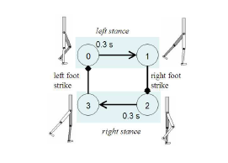
Decisions

Slide 126
Decisions
Finite state machines are usually constructed by hand and consist of a small number of states
They are usually used for short term limited duration motions
In this case we have used them for dynamics, but they can also be used for inverse kinematics and even key based techniques
For example an animator can create a number of short animations that are then sequenced using a finite state machine
This technique has been used in a number of games

Slide 127
Decisions
Motion graphs were originally developed to splice together motion capture data
In this case the nodes are poses or stances of the character and the edges are the different motion capture sequences that move from one pose to another
The motion capture data is analyzed to determine good cut points and common poses that can be used to splice together motion sequences
An abstract example of a motion graph is shown on the next slide, they are typically much longer

Slide 128
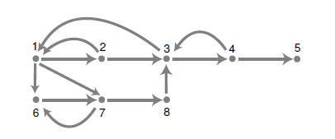
Decisions

Slide 129
Decisions
The character skeleton is extracted from the motion capture data, and this data is analyzed to construct the motion graph
There are rarely common poses in motion capture data, instead poses that are close to similar are detected and then transitions are constructed by interpolating between the two motion sequences
Usually the last few frames of one sequence is interpolated to the first few frames of the next sequence

Slide 130
Decisions
Most of the motion sequences in the graph are quite short, usually one motion capture sequence is cut into a number of shorter sequences
Techniques have been developed to change the length of a sequence and for retargeting the motion to other characters
This is still an active research area

Slide 131
Sensor-Actuator Networks
Sensor-actuator networks (SAN) were developed by Michiel van de Panne and presented at Siggraph’93
This was one of the first attempts to automatically construct controllers for particular types of motions
An example of this is a controller for locomotion or walking
The idea is to evolve a motion controller that produces interesting motion
Interesting motion is defined by a performance function that measures the performance of the motion controller

Slide 132
Sensor-Actuator Networks
In the case of locomotion the performance function is the distance the character moves in a fixed length of time
The controller is used with a dynamics simulation of the character, the simulation is run for a fixed length of time (6 seconds) and the distance the character moved is measured
The controller that produces the greatest distance is the one that is selected
The method is based on adding a control network to an articulated creature

Slide 133
Sensor-Actuator Networks
The creature consists of a typical articulated body, a set of sensors on the body and actuators that apply forces or torques to the joints
The sensors are binary and typically sense ground contact and joint limits
The actuators can be either a single angle that generates a torque, or length actuator that generates a force
An example creature is shown on the next slide, and is typical of the creatures used in this work

Slide 134
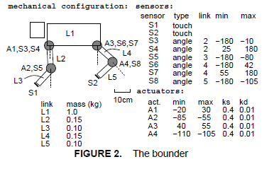
Sensor-Actuator Networks

Slide 135
Sensor-Actuator Networks
The sensors and actuators are connected by a network, there is one node for each of the sensors and actuators, plus a hidden level between the sensors and actuators
It is a completely connected network with each node connected to all of the other nodes, an example is shown on the next slide
Each edge in the network has a weight, in this case integers between -2 and +2 are used
Each node sums the input signals and output a 1 if the sum is greater than zero
A hysteresis is added to this function as shown on the next slide

Slide 136
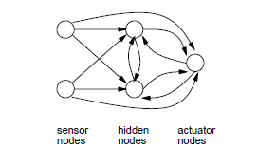
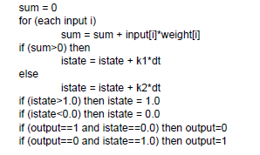
Sensor-Actuator Networks

Slide 137
Sensor-Actuator Networks
The actuator nodes convert their input signals into a torque or force
The generation of the controllers is done in two phases
The first phase is an exploration phase, in this phase several hundred random controllers are generated by randomly selecting the weights for each of the edges
These controllers are then simulated to determine their performance
The top 1-5% of the SANs produced in this phase are selected for the second phase

Slide 138
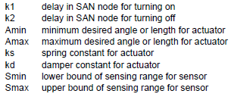
Sensor-Actuator Networks
The result of the first phase is controllers that produce an interesting motion, but its not optimal
In the second phase the controller parameters are tuned to produce a better result, the parameters that are considered in this phase are:

Slide 139
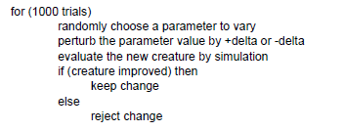
Sensor-Actuator Networks
A stochastic gradient ascent algorithm is used to tune the parameters, basically randomly change a parameter and if it improves the performance keep the change
The algorithm is:

Slide 140
Sensor-Actuator Networks
This technique produced a number of interesting motions for simple characters
The characters were basically 2D (flat), but they moved in a 3D environment, so balance wasn’t an important consideration, even though some creatures did fall over
The technique was successful enough to motivate more research over the years, and this is still a very active research area

Slide 141
Summary
Examined techniques for behavioral animation, characters control their own motion
Model based on sensors, actuators and decision processes
Examined collision detection and avoidance, kinematics, inverse kinematics and dynamics
Boids used as an example

